Slide 1
Introducting new bicycle parking locations

Slide 2
Introduction
Düsseldorf is a city on the River Rhine in western Germany and is the capital city of the state of North Rhine-Westphalia. It is one of the economic centers of the country,
City have some official bicycle parking spots but most all of them are located on railway station. Can we endorse a location in Duesseldorf to open a new bicycle parking?.
New bicycle parking spot will motivate people to go shopping or hangout on bicycles which can reduce the traffic and car parking problem in the city.

Slide 3
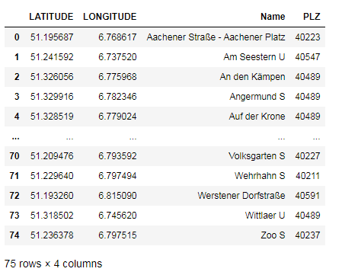
Data sources

Slide 4
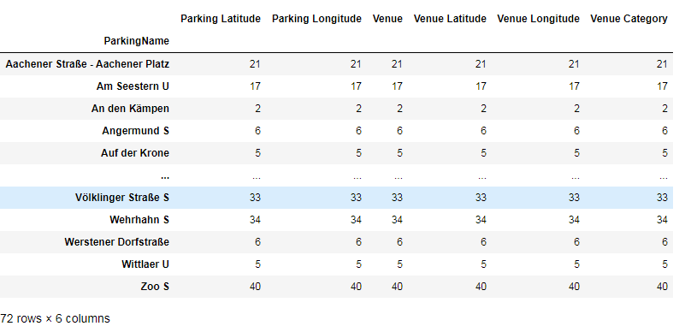
Analysis
utilizing the Foursquare API to explore the neighborhoods and segment them.

Slide 5
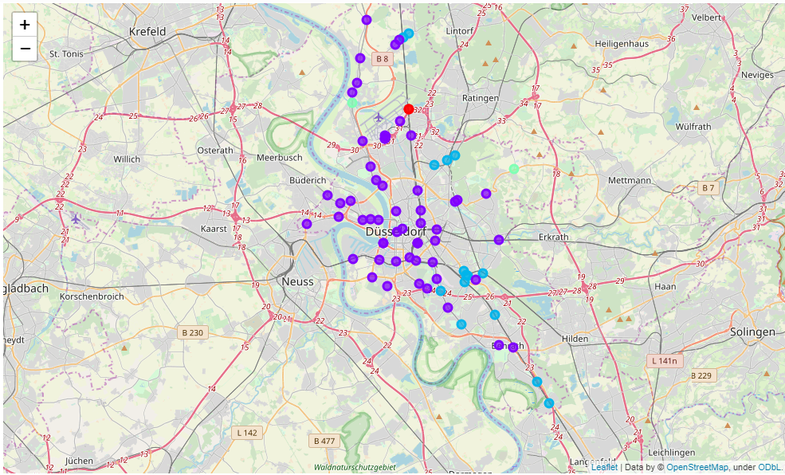
Clustering
Run k-means to cluster the parkings into 5 clusters

Slide 6
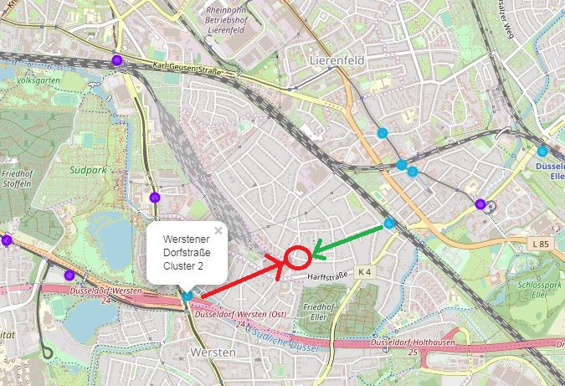
Results
As shown in the figure above a new bike parking station between ‘Werstener Dorfstrasse’ and ‘Eller Süd’ may provide an efficient bicycle parking place for the for the riders.

